Slide 1

Game

Slide 2

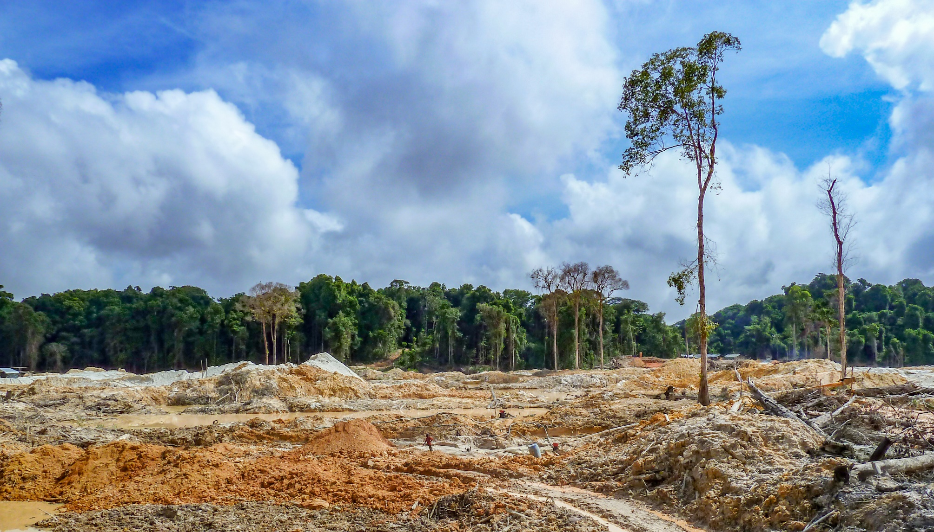


ENGAGE
World leaders promise to end deforestation by 2030
How will this help slow down climate change?

Slide 3
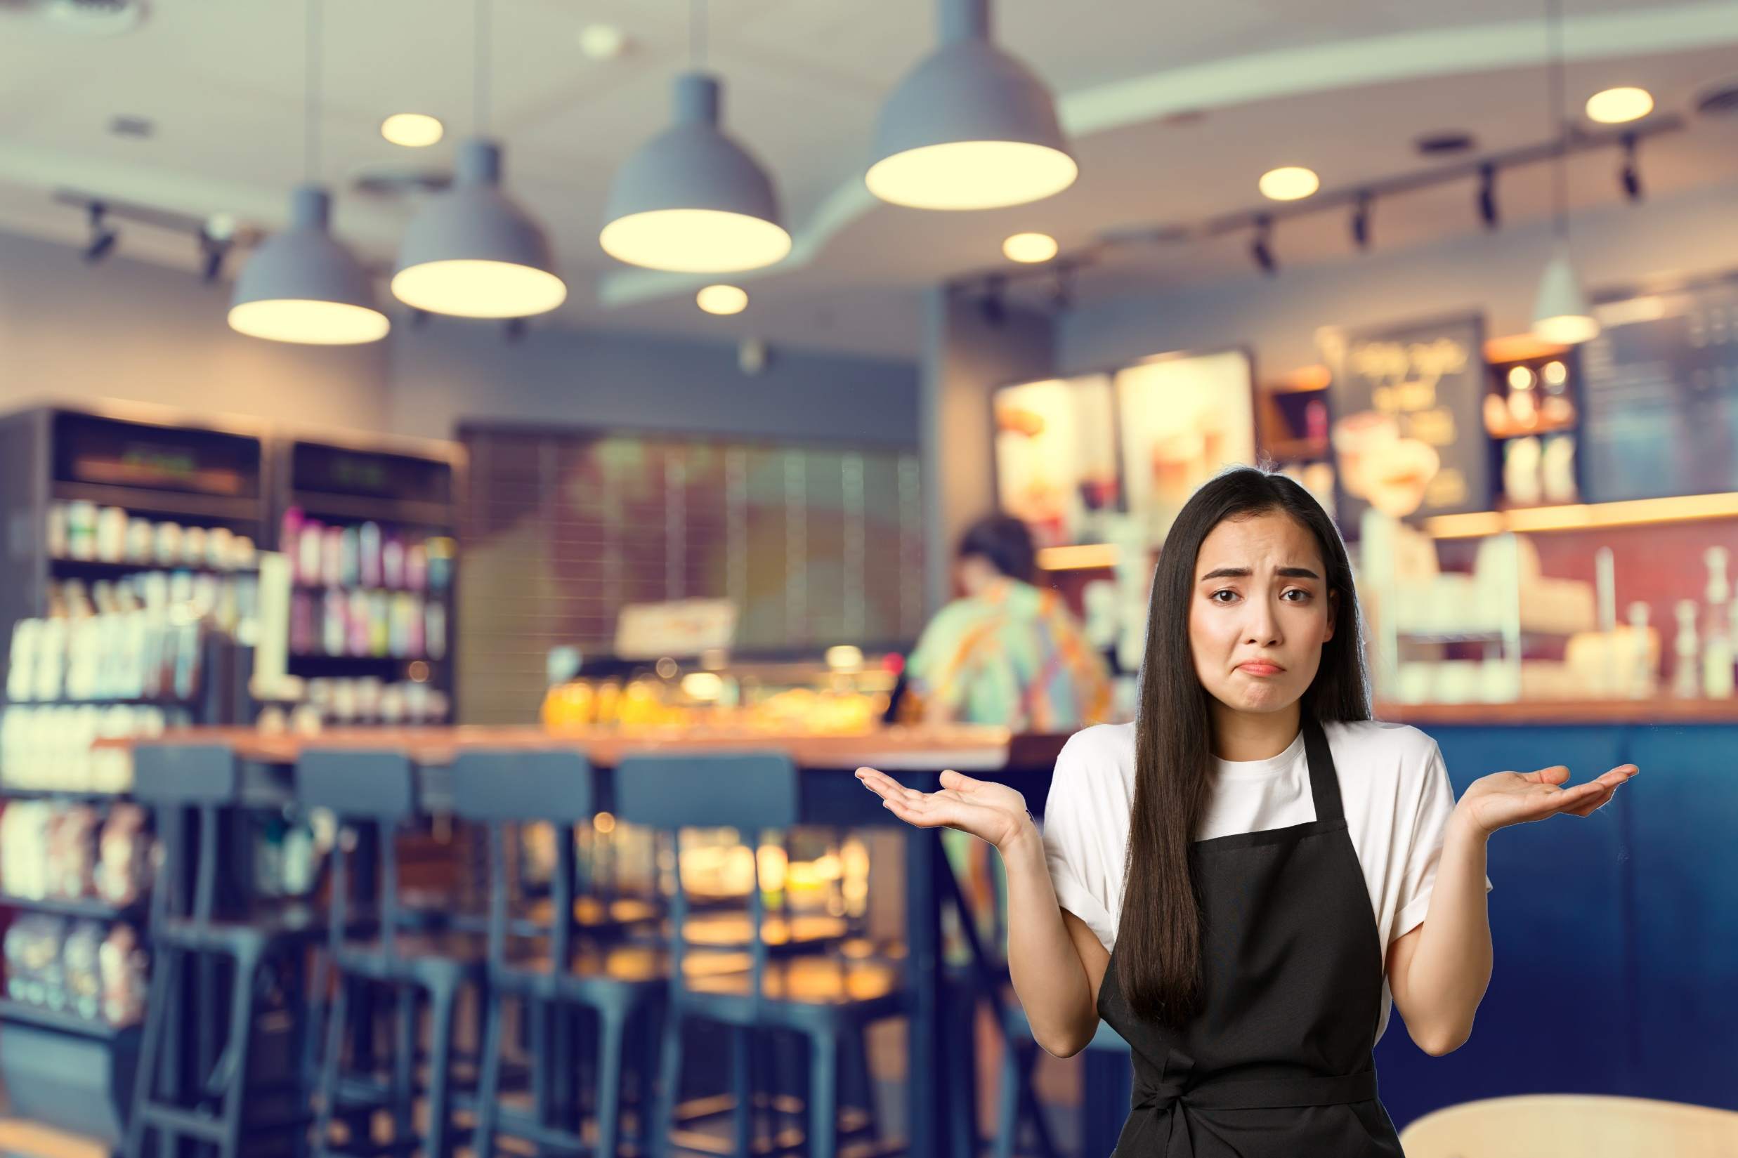


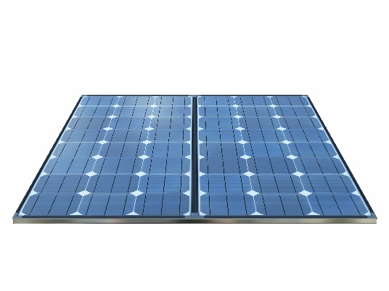

I need your help to make my café carbon neutral. I’ve been researching different ways to reduce our CO₂ emissions.
But I can’t afford to do them all.
How can I decide which actions are best?

Slide 4

In this lesson, you will:
Learn how to make a scientific decision by examining the consequences of different actions

Slide 5



EXPLAIN
How can we decide which actions are best?
One way is to think of all the
possible consequences.
Social
Economic
Environmental
How might people be affected?
How much money does it cost?
How might habitats be affected?

Slide 6
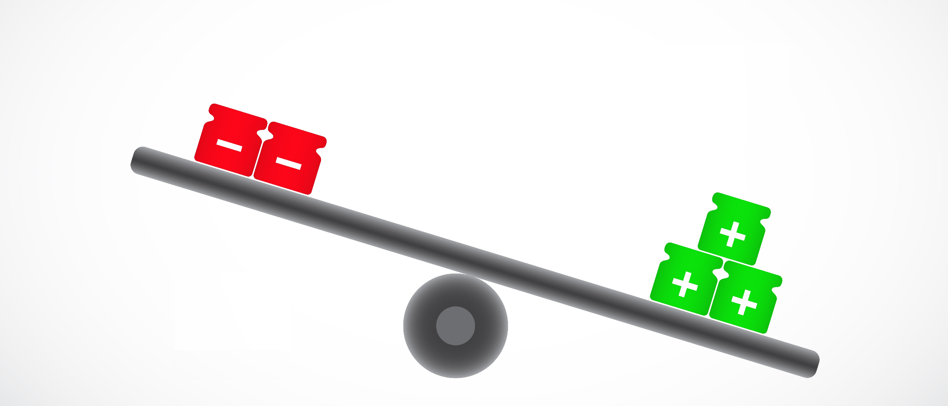
EXPLAIN
Consequences may be positive or negative.
To make a decision you weigh them up:
Negative consequences
Positive consequences

Slide 7


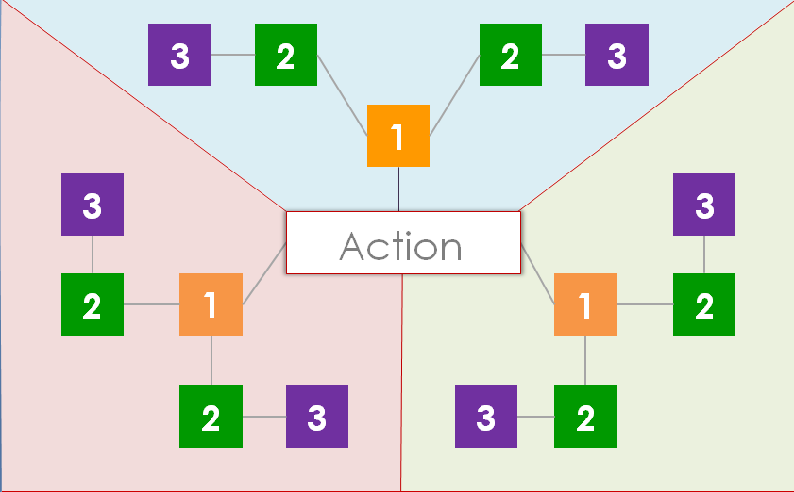
GUIDE
Practise making scientific decisions by playing the Consequences Game.
Should...
Activity: Consequences Game
Work in a group of 3.
Cut out the blank cards (SS1).
Read the rules (SS2).
Play the game on the board (SS3).
Decide if the action is a good idea.

Slide 8
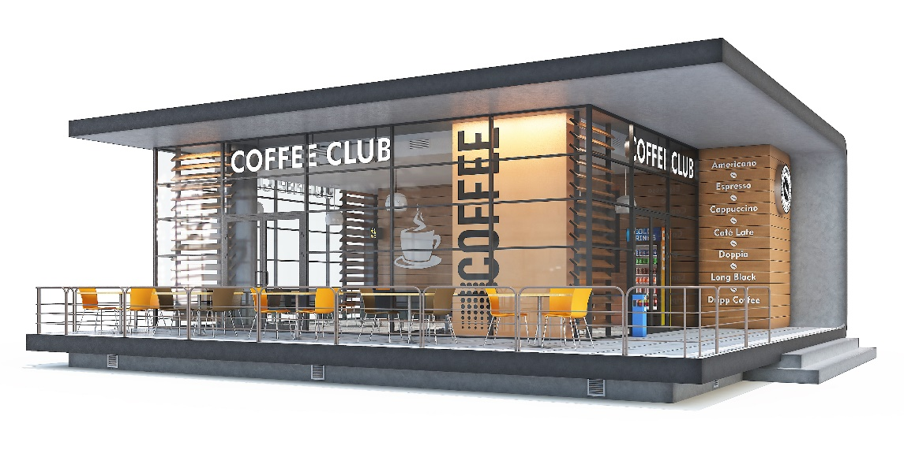
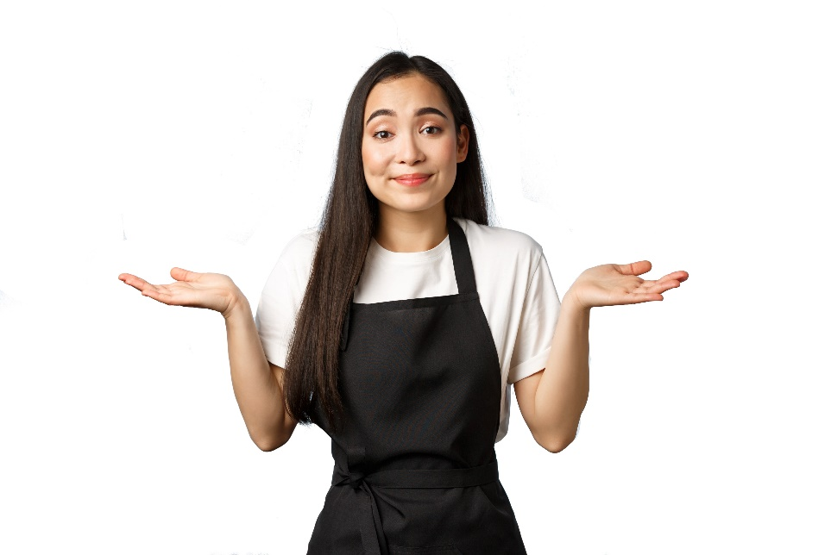
EMPOWER
Please look at the actions to reduce my café’s CO₂ emissions and their consequences.
Remember, we only have a limited budget.
Activity: Examine the consequences SS4-6
Have each person in a group take one problem: transport (SS4), electricity (SS5) and waste (SS6).
Go through the consequences of each action.
Decide which one is best, with reasons.
Explain your choice to the group.

Slide 9
Game
Student sheets

Slide 10
Game cards
SS1

Slide 11
Game rules
SS2
You will need:
A game of consequences board
Blank cards cut up
A consequence is an action that has an effect that can be negative or positive
Red and green pen/pencil
3 players
Instructions
1 Write the action on the large card and place in the centre of the board.
2 Place the other cards in a pile.
3 The first player thinks of one consequence of the action and shares it with the other players. If they agree that it is a consequence then the player takes a small card from the pile and writes on the consequence along with their initials. This is placed on one of the boxes marked with a 1. Take it in turns so all the ‘1’ boxes are filled up.
4 Now, you must fill up the boxes marked with a 2 only. These are consequences
of the suggestions in the ‘1’ boxes.
5 Continue until all the ‘2’ boxes are filled. Then move onto the ‘3’ boxes.
6 When all boxes are filled, go through each
of the ‘2’ and ‘3’ boxes and decide if it is
a negative or positive consequence
(some might be both). Mark all the negative consequences with the red pen and positive with the green pen.
7 Then, count up how many consequences are negative and how many are positive.

Slide 12
Game of consequences board
SS3
3
2
2
3
1
3
3
Action
2
1
1
2
2
3
3
2
Student sheets

Slide 13
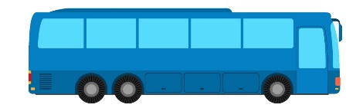


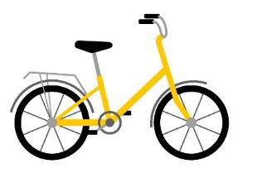

Problem: Transport
Problem: Transport
SS4
SS4
Transport releases carbon dioxide:
Staff travel to the café. Some use vehicles that burn petrol or diesel.
Café supplies are delivered in a lorry once a week from a wholesalers 10 km away.
Supplies come from around the world e.g. coffee from Brazil and milk from all around the UK.
Transport releases carbon dioxide:
Staff travel to the café. Some use vehicles that burn petrol or diesel.
Café supplies are delivered in a lorry once a week from a wholesalers 10 km away.
Supplies come from around the world e.g. coffee from Brazil and milk from all around the UK.
Action 1: Demand that all staff walk, cycle or use public transport to get to work.
Cost: £££
Carbon reduction:
Action 1: Demand that all staff walk, cycle or use public transport to get to work.
Cost: £££
Carbon reduction:
Action 2: Buy all staff a bike so they can cycle to work.
Cost: £££
Carbon reduction:
Action 2: Buy all staff a bike so they can cycle to work.
Cost: £££
Carbon reduction:
Action 3: Where possible, buy goods from local suppliers e.g. milk from a nearby farm. They may be more expensive but they don’t have to travel so far.
Cost: £££
Carbon reduction:
Action 3: Where possible, buy goods from local suppliers e.g. milk from a nearby farm. They may be more expensive but they don’t have to travel so far.
Cost: £££
Carbon reduction:

Slide 14
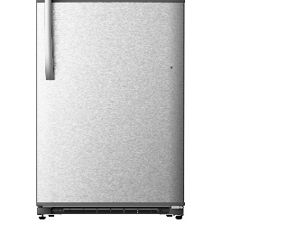

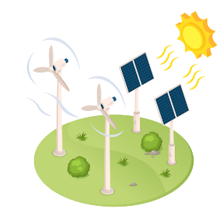

Problem: Electricity
SS5
Problem: Electricity
SS5
Using electricity releases carbon dioxide:
The café uses electricity for light and heat.
There are many electrical appliances – a coffee machine, dishwasher and fridge.
The café buys electricity from a supplier who uses fossil fuel power stations. Burning fossil fuels (coal, oil and gas) releases carbon dioxide.
Using electricity releases carbon dioxide:
The café uses electricity for light and heat.
There are many electrical appliances – a coffee machine, dishwasher and fridge.
The café buys electricity from a supplier who uses fossil fuel power stations. Burning fossil fuels (coal, oil and gas) releases carbon dioxide.
Action 1: Buy new appliances that are energy efficient. They are expensive to buy but use less electricity so will also save money in electricity bills.
Cost: £££
Carbon reduction:
Action 1: Buy new appliances that are energy efficient. They are expensive to buy but use less electricity so will also save money in electricity bills.
Cost: £££
Carbon reduction:
Action 2: Swap to a new electricity supplier that is more expensive per unit but only buys electricity from sources that release no CO₂ e.g. wind farms.
Cost: £££
Carbon reduction:
Action 2: Swap to a new electricity supplier that is more expensive per unit but only buys electricity from sources that release no CO₂ e.g. wind farms.
Cost: £££
Carbon reduction:
Action 3: Put solar panels on the roof. They are very expensive to buy, but it will mean the café can buy less electricity from a supplier, saving money in the long-term.
Cost: £££
Carbon reduction:
Action 3: Put solar panels on the roof. They are very expensive to buy, but it will mean the café can buy less electricity from a supplier, saving money in the long-term.
Cost: £££
Carbon reduction:

Slide 15
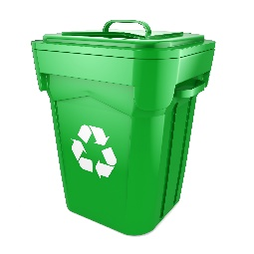

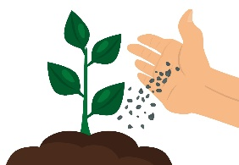
Problem: Waste
SS6
Problem: Waste
SS6
Waste releases carbon dioxide:
Rubbish put into bins ends up in landfills or is burnt in an incinerator.
In landfills, bacteria decay the rubbish and release carbon dioxide.
Burning rubbish releases carbon dioxide.
Waste releases carbon dioxide:
Rubbish put into bins ends up in landfills or is burnt in an incinerator.
In landfills, bacteria decay the rubbish and release carbon dioxide.
Burning rubbish releases carbon dioxide.
Action 1: Reduce packaging or use recyclable packaging (which is more expensive). Encourage customers to recycle their cups.
Cost: £££
Carbon reduction:
Action 1: Reduce packaging or use recyclable packaging (which is more expensive). Encourage customers to recycle their cups.
Cost: £££
Carbon reduction:
Action 2: Sell reusable cups with the café name on them, and give customers a 10% discount on their drink if they use one.
Cost: £££
Carbon reduction:
Action 2: Sell reusable cups with the café name on them, and give customers a 10% discount on their drink if they use one.
Cost: £££
Carbon reduction:
COFFEE
CLUB
COFFEE
CLUB
Action 3: Donate all left-over food to a homeless charity and used coffee grounds to the local allotments (it is great fertiliser).
Cost: £££
Carbon reduction:
Action 3: Donate all left-over food to a homeless charity and used coffee grounds to the local allotments (it is great fertiliser).
Cost: £££
Carbon reduction:

